Slide 1
Welcome

Slide 2

Government Women Residence Polytechnic, Tasgaon
Department of Information Technology
Project Synopsis
on
“Hostel Management System”

Slide 3
Submitted by:
ROLL NO. | NAME
17539 | Mali Nayana Suresh
15228 | Jamadade Shreya Ajay
15247 | Wagh Pranjal Sukhdev
15251 | Patil Rutuja
Submitted to:
Guide name: Miss. R. B. Varne

Slide 4
Rationale/Abstract:
This system is designed in favor of the hostel management which helps them to save the records of the students about their rooms and other things. It helps them from the manual work from which it is very difficult to find the record of the students and the mess bills of the students, and the information of about the those ones who had left the hostel three years before.
We design this system on the request of the hostel management, through this they cannot require so efficient person to handle and calculate the things. This system automatically calculates all the bills and issued the notifications for those students who are against some rules.

Slide 5
Introduction:
Hostel Management System is an online website which is developed using SQL for backend and ASP.NET for frontend.
It is used for managing the complex data of any hostel through internet.
Any person who is the owner of a hostel or a group of hostels can use it to decrease the complexity of its hostel management and reduce the stress and tension just by paying a reasonable amount of money to developer.
There are four types of languages are used in developing the Hostel Management System.

Slide 6
Features:
Easy Installation
User friendly interface requiring minimal IT skills.
Parents /Guardians/staff details on a click.
Enables to handle your responsibility of student safety effectively .
Multiple Campus can be integrated .
Real time and historical reports of entry and exit of student into and hostel.

Slide 7
Literature Survey:
computerized building. It’s very difficult perform the repetitive task by the authorized person to the existing data, we need to search and perform all the modification, upgradations and other activity. It is times consume activity and data may be lost due to the data written manually in pen and paper. Also maintaining the data in hard copy is not so secure, because unauthorized persons will steal the data and can also perform some inconsistence modification to the existing data. If the admin or hostel clerk needs any type of information regarding any student who is currently living in his hostel, then he has to check and open various registers and then also it is not completely sure that he can get the information in the meantime. And if the required information is regarding the student who left the hostel then it is completely a very complex task because the registers containing the information of the student who left the hostel can be sold

Slide 8
Problem Definition:

Slide 9
Proposed Methodology:
• To maintain the information with high secure.
• Data redundancy can be avoided to some extent
• Easy data updating
• Easy record keeping
• Backup data can be easily generated

Slide 10
System Description & Significance:
To provide alert for upcoming vaccination with its price based on birth date of the baby according to immunization chart prescribed by government of India.
It also helps the customers to find the address and contact numbers of nearby hospitals for treatments.
Keep a track of your child’s growth by storing information like his height and weight to get graphical details about his growth.
To provide description of vaccination along with its side effects if any.
Quick view summary report of child’s completed and upcoming vaccines.
Send a message regarding Polio vaccination date and location of nearest Polio booth.

Slide 11
System Architecture:

Slide 12
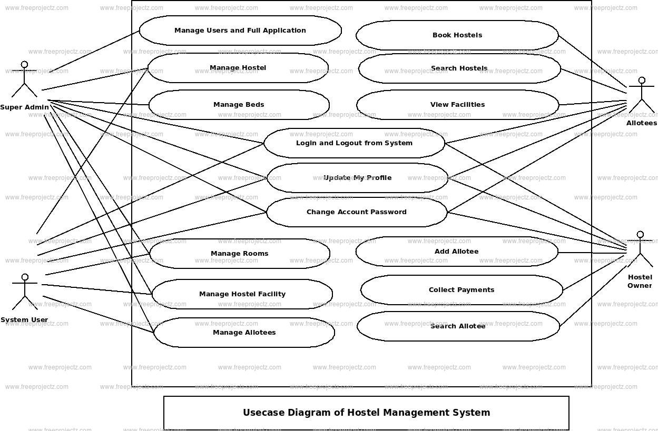
Use case diagram:
Use case diagram:
A use case diagram is useful to view a set of use cases and actors that is a special type of class and their relationships.
Actor:
An actor in the unified modelling language “specifies a role played by user or any other system that interact with the subject”.

Slide 13
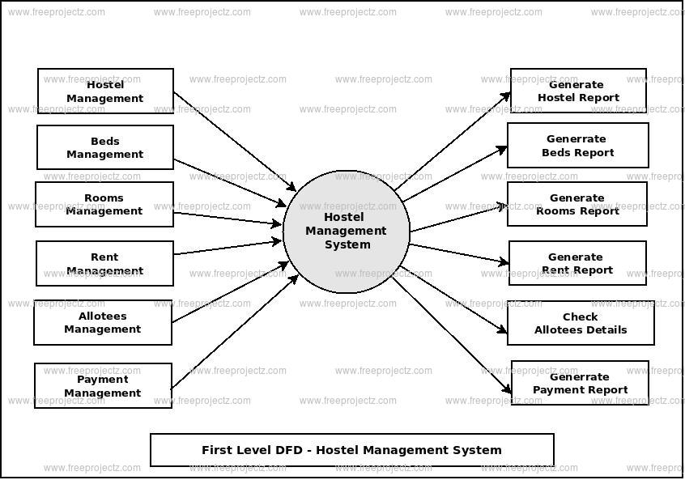
E-R diagram: An entity relationship diagram which shows the relationships of an entity sets stored in a database

Slide 14
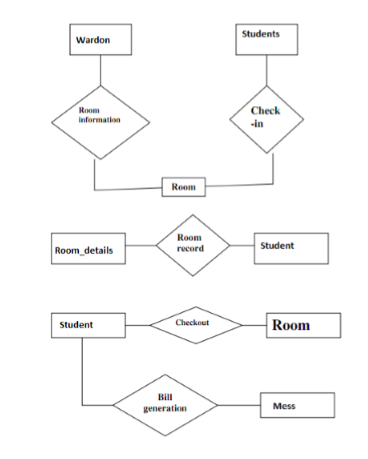
Class diagram:

Slide 15
Resource Required:

Slide 16
Advantages:
Accessible at anytime, anywhere.
Keep the records safe with vaccination app.
Remainder via constants alerts.

Slide 17
Disadvantages:
Every person should be known English language.
Smart phones are required for this app.

Slide 18
Applications:
This module will support for student leave/permission and outing .
Students presents and absent status alerts can be sent through SMS/Email.
It provides an easy process for monitoring hostel student activities by warden.
Parents have to give confirmation for their wards.
The gate pass will be handed over to the security in the gate by the student.

Slide 19
Conclusion:
Thus we have developed Asp.net-SQL server source code which would help in developing the online student information –Hostel Management System. It will reduce the effort made by the management while maintaining the hostel. It will remove the pen and paper. concept which is being used by us from earlier times. It is online software/website so anyone can access it from anywhere without any complexity with the help

Slide 20
THANK YOU

